Slide 1

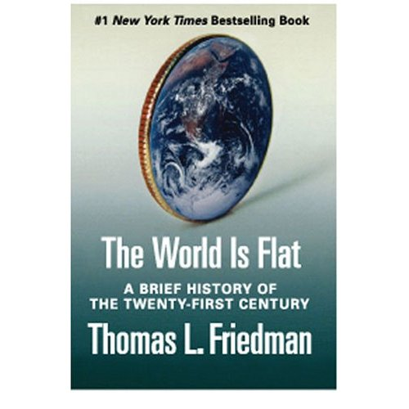
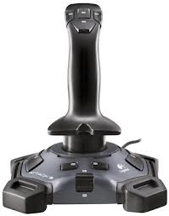
The World Is Flat
The World is Flat
Logitech Attack 3
Logitech attack3
An international bestselling book by Thomas Friedman that analyzes globalization, primarily in the early 21st century. The title is a metaphor for viewing the world as a level playing field in terms of commerce, where all competitors have an equal opportunity.
No matter how you like to fly, the Logitech Attack 3 Joystick will give you maximum control with minimum hassle. As soon as you wrap either hand around the comfortable handle, you'll immediately feel the smooth performance and precise control that tell you one important fact: This is no ordinary joystick.
Logitech Company
Author
Features
Detail

Slide 2

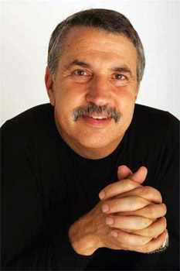
Thomas Lauren Friedman
The World is Flat
Logitech attack3
Logitech Company
An American journalist, columnist and author. He writes a twice-weekly column for The New York Times. He has written extensively on foreign affairs including global trade, the Middle East, globalization, and environmental issues and has won the Pulitzer Prize three times.
Author
Logitech is a world leader in products that connect people to the digital experiences they care about. Spanning multiple computing, communication and entertainment platforms, Logitech’s combined hardware and software enable or enhance digital navigation, music and video entertainment, gaming, social networking, audio and video communication over the Internet, video security and home-entertainment control.
Features
Detail

Slide 3

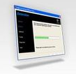
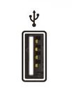

Ten flatteners
The World is Flat
Logitech Attack 3
Logitech attack3
Collapse of the Berlin Wall
Workflow software
Netscape
Supply chain
Logitech Company
Offshoring
Insourcing
Author
Uploading
Informing
Features
Outsourcing
“The Sterois”
Detail

Slide 4

Collapse of the Berlin Wall
The World is Flat
Full Array of Control
Logitech attack3
Friedman called the flattener, "When the walls came down, and the windows came up." The event not only symbolized the end of the Cold War, it allowed people from the other side of the wall to join the economic mainstream. "11/9/89" is a discussion about the Berlin Wall coming down, the "fall" of communism, and the impact that Windows powered PCs (personal computers) had on the ability of individuals to create their own content and connect to one another. At that point, the basic platform for the revolution to follow was created: IBM PC, Windows, a standardized graphical interface for word processing, dial-up modems, a standardized tool for communication, and a global phone network.
Logitech Company
Author
You can assert your self with 11 programmable buttons and a rapid-fire trigger.
Features
Back
Detail
Back

Slide 5

Netscape
The World is Flat
Plug-and-play setup
Logitech attack3
Netscape went public at the price of $28. Netscape and the Web broadened the audience for the Internet from its roots as a communications medium used primarily by "early adopters and geeks" to something that made the Internet accessible to everyone from five-year-olds to ninety-five-year-olds. The digitization that took place meant that everyday occurrences such as words, files, films, music, and pictures could be accessed and manipulated on a computer screen by all people across the world.
Logitech Company
It delivers plug-and-play simplicity – or you can install the induced software to customized buttons
Author
Features
Back
Detail
Back

Slide 6
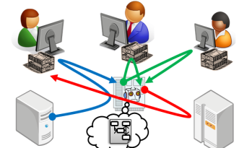
Workflow Software
The World is Flat
Logitech Gaming software (PC)
Logitech attack3
Friedman's catch-all for the standards and technologies that allowed work to flow. The ability of machines to talk to other machines with no humans involved, as stated by Friedman. Friedman believes these first three forces have become a "crude foundation of a whole new global platform for collaboration." There was an emergence of software protocols (SMTP – simple mail transfer protocol; HTML – the language that enabled anyone to design and publish documents that could be transmitted to and read on any computer anywhere) Standards on Standards. This is what Friedman called the "Genesis moment of the flat world." The net result "is that people can work with other people on more stuff than ever before." This created a global platform for multiple forms of collaboration. The next six flatteners sprung from this platform.
Logitech Company
Advanced button customization, multiple controller configurations, and printable gaming profiles let you get serious about your game.
Author
Features
Back
Detail
Back

Slide 7
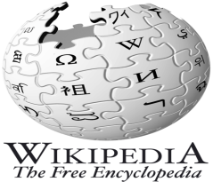
Uploading
The World is Flat
Logitech Gaming software (PC)
Logitech attack3
Communities uploading and collaborating on online projects. Examples include open source software, blogs, and Wikipedia. Friedman considers the phenomenon "the most disruptive force of all."
Logitech Company
Author
Advanced button customization, multiple controller configurations, and printable gaming profiles let you get serious about your game.
Features
Back
Detail
Back

Slide 8
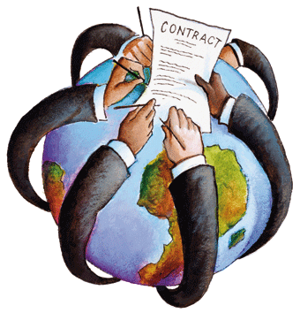
Outsourcing
The World is Flat
Logitech attack3
Friedman argues that outsourcing has allowed companies to split service and manufacturing activities into components which can be subcontracted and performed in the most efficient, cost-effective way. This process became easier with the mass distribution of fiber optic cables during the introduction of the World Wide Web.
Logitech Company
Author
Features
Detail
Back

Slide 9
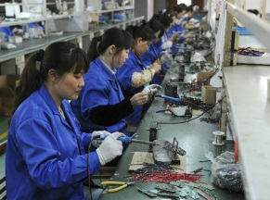
Offshoring
The World is Flat
Logitech attack3
The internal relocation of a company's manufacturing or other processes to a foreign land to take advantage of less costly operations there. China's entrance in the WTO (World Trade Organization) allowed for greater competition in the playing field. Now countries such as Malaysia, Mexico, Brazil must compete against China and each other to have businesses offshore to them.
Logitech Company
Author
Features
Detail
Back

Slide 10
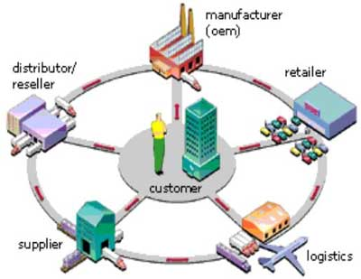
Supply-chaining
The World is Flat
Logitech attack3
Friedman compares the modern retail supply chain to a river, and points to Wal-Mart as the best example of a company using technology to streamline item sales, distribution, and shipping.
Logitech Company
Author
Features
Detail
Back

Slide 11

Insourcing
The World is Flat
Logitech attack3
Friedman uses UPS as a prime example for insourcing, in which the company's employees perform services – beyond shipping – for another company. For example, UPS repairs Toshiba computers on behalf of Toshiba. The work is done at the UPS hub, by UPS employees.
Logitech Company
Author
Features
Detail
Back

Slide 12

Informing
The World is Flat
Logitech attack3
Google and other search engines are the prime example. "Never before in the history of the planet have so many people – on their own – had the ability to find so much information about so many things and about so many other people," writes Friedman. The growth of search engines is tremendous; for example take Google, in which Friedman states that it is "now processing roughly one billion searches per day, up from 150 million just three years ago."
Logitech Company
Author
Features
Detail
Back

Slide 13

"The Steroids"
The World is Flat
Logitech attack3
Wireless, Voice over Internet, and file sharing. Personal digital devices like mobile phones, iPods, personal digital assistants, instant messaging, and voice over Internet Protocol (VoIP). Digital, Mobile, Personal and Virtual – all analog content and processes (from entertainment to photography to word processing) can be digitized and therefore shaped, manipulated and transmitted; virtual – these processes can be done at high speed with total ease; mobile – can be done anywhere, anytime by anyone; and personal – can be done by you.
Logitech Company
Author
Features
Detail
Back

